Slide 1
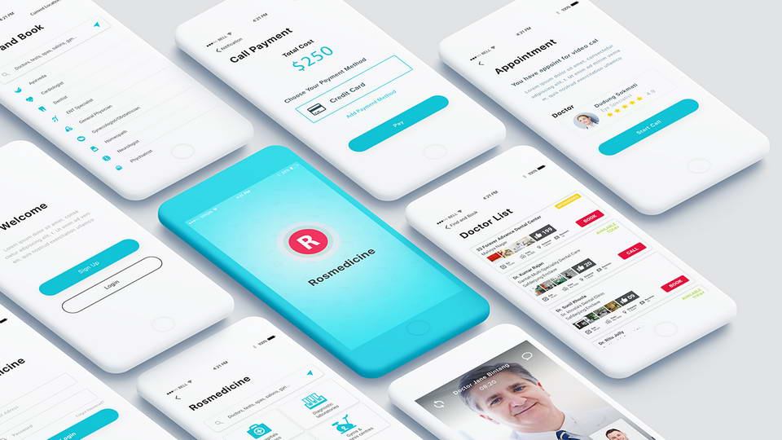
Medical Assistant Project
App Name-SYMONE
THE INSOMANIACS
Avnish Ranwa
Bhanu Soni
Dhruv Soni
Divyanshu Tripathy

Slide 2
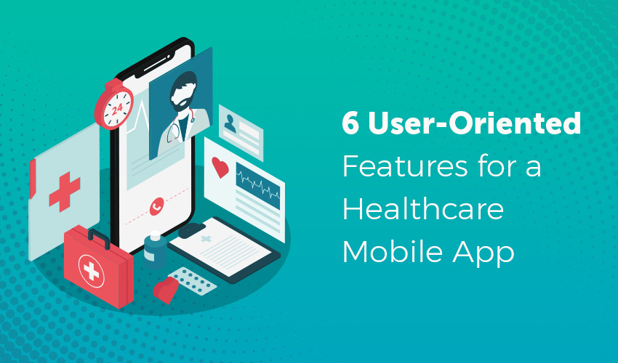
OVERVIEW
We are creating a medical assistant interface for doctors which will have the following features:
Take and record patient history and medical information
Measure vital signs of the patient
Help the physician with patient examinations
Give patient medicine as directed by the physician
Schedule patient appointments and notify the patients about their appointments

Slide 3
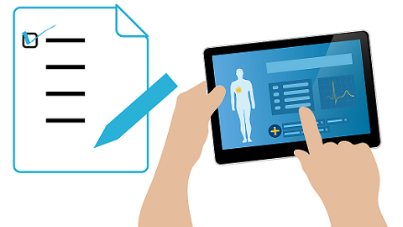

Whole record of each patient will be visible to the doctors :
Healthcare teams should only be able to view the records of patients with whom they have a direct clinical relationship. This means that the patient must be registered on the system of the organization which wishes to view their record, for example as a result of referral. It should not be possible for one organization to view all of the records of another organization.
It is appropriate for GPs to view information recorded by other healthcare professionals when caring for their patients, unless the patient dissents.

Slide 4

Legitimate relationships :
Healthcare professionals should only view the information relevant to their care setting, unless the patient has given their explicit consent for the full record to be viewed. In the BMA’s view, it is unnecessary for a physiotherapist treating ligament damage to access the entire medical history, for example.
Traditional referrals result in relevant information being shared with the treating clinician. This occurs under implied consent. Systems that disclose the entire patient record to the treating clinician require explicit consent.
Clinical systems -
If a patient agrees to a shared record with Doctor, they can specify which organizations can view their record. Only the information that is set out in the sharing agreements, If the patient opts out of streaming, then their record is not available.
If a patient selects the ‘share’ option, then they can tailor which organization can see their records. In addition, the information available is set out in the sharing agreement and tailored to the healthcare professional.
A share in/share out model is used for Symone. A healthcare professional in a multi-disciplinary team treating a patient may ask the patient for their consent to see their record. This is ’share in’. They may then ask if the patient consents for that record to be shared with the rest of the multi disciplinary team, this is ’share out’.

Slide 5

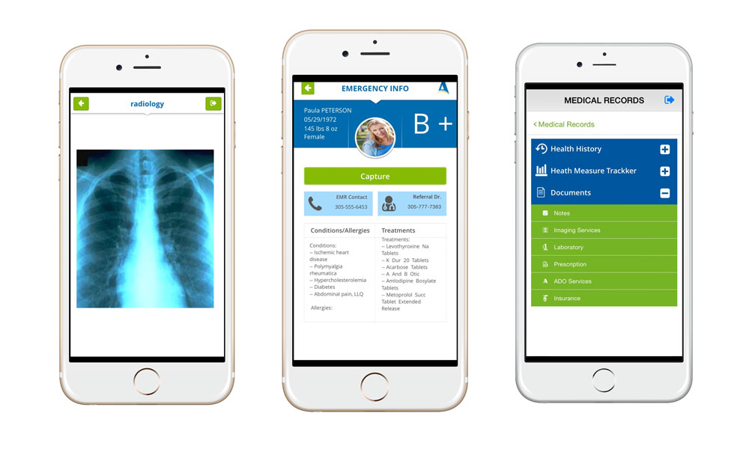
Sharing records :
In exceptional circumstances, for example if the patient is unconscious and immediate access to the record is needed, it may be appropriate to access the record without consent.
Healthcare professionals must indicate on the system a reason for this. An override may not be possible if a patient has dissented from a shared record.

Slide 6
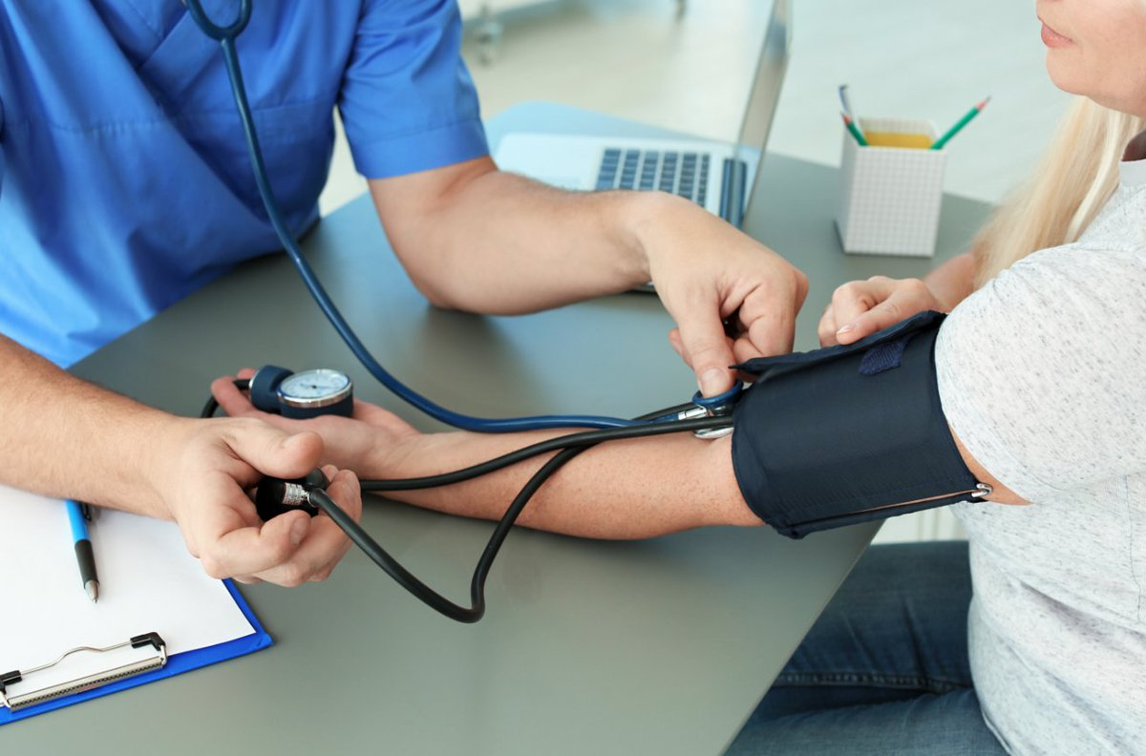
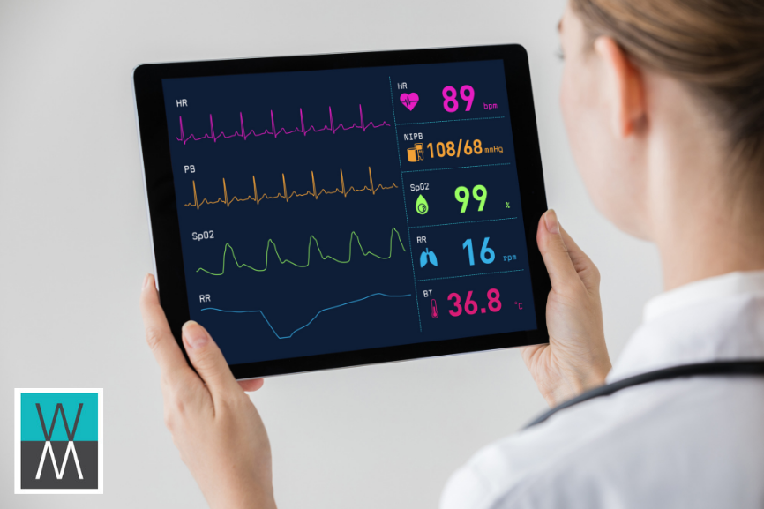
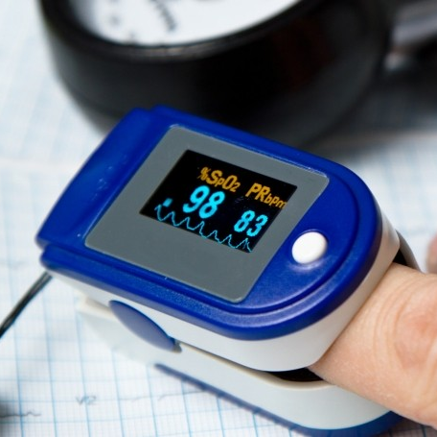
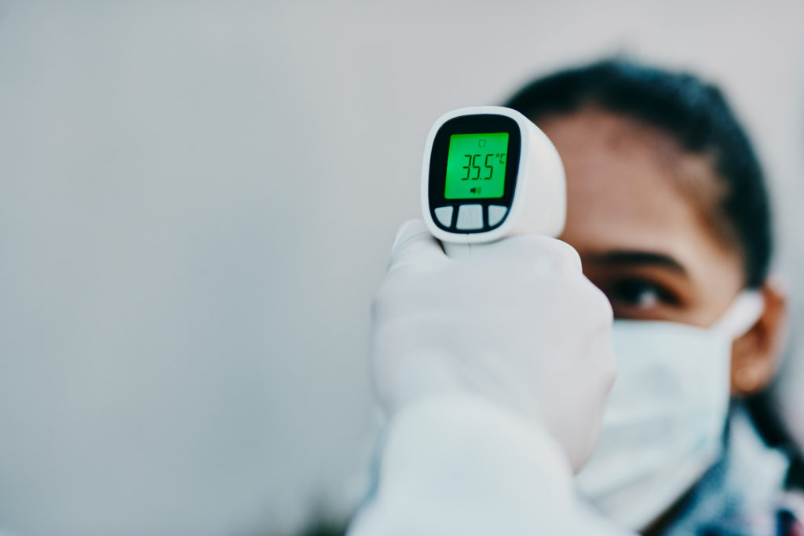
Measure vital signs of the patient:
The system for measuring the vital signs of the user is capable of integrating up to six medical sensors. The system is able to adapt to the needs of the patient and set the sensors required to monitor their medical problems. There are nine medical sensors that make up the network of biometric sensors; the functionality of each is described below:
Patient position sensor: This sensor oversees five different patient positions (standing or sitting, supine, prone, left and right). In many cases, it is necessary to control body positions and movements performed because of a relationship with chronic diseases (sleep apnea or restless legs syndrome). Analyzing the movements during sleep can also help determine the quality of sleep and irregular sleep patterns
Glucose sensor or glucometer: A medical device to determine the approximate concentration of glucose in the blood. A small drop of blood, obtained by pricking the skin with a lancet, is placed on a disposable test strip which is read by the meter and used to calculate the blood glucose level. The meter then displays the level in mg/dl or mmol/l.
Temperature sensor or thermometer: This sensor can measure body temperature. This data is of great medical importance as it can quickly determine if there are any health problems. Likewise, the course of certain diseases can be monitored by measuring body temperature, and the efficiency of a treatment initiated can be evaluated by the physician.
Blood pressure sensor: Blood pressure is the pressure of the blood in the arteries as it is pumped around the body by the heart. Blood pressure is recorded as two numbers the systolic pressure (as the heart beats) over the diastolic pressure (as the heart relaxes between beats).
Pulse and Oxygen in Blood: Oxygen saturation is defined as the measurement of the amount of oxygen dissolved in the blood, based on the detection of Hemoglobin and Deoxyhemoglobin.
Airflow sensor: Abnormal respiratory rates and changes in respiratory rate are a broad indicator of major physiological instabilities. Therefore, it is critical to monitor respiratory rate as an indicator of patient status. Airflow sensor can provide an early warning of hypoxemia and apnea.

Slide 7
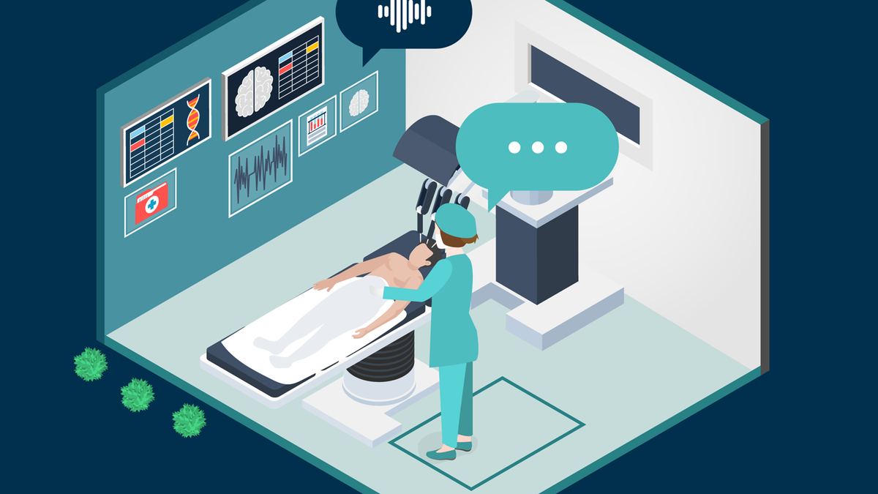
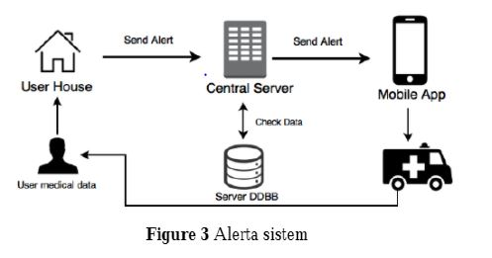
Alert system for ambulances: The central server is responsible for evaluating the alerts that have been sent by the measurement system in the user's home (Figure 3). An alert occurs if, while measuring the user’s vital signs, the system records a value that has been marked outside the "normal" range for that user. This value, which is sent to the central server, is compared with the patient’s historical data. If the data sent are not compatible with those on record, the system determines that it is an emergency. When this occurs, the system sends a notification to the ambulance nearest to the home user. Ambulances associated with the system have a mobile device with the emergencies application installed. This application receives geolocation information from home user and calculates the shortest route to get there.

Slide 8
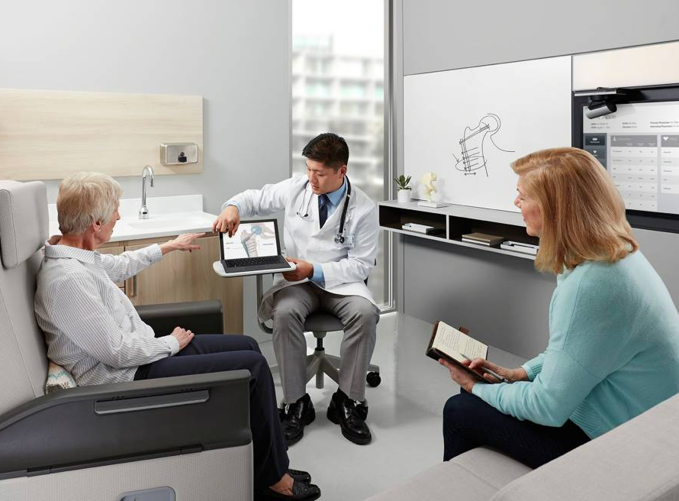
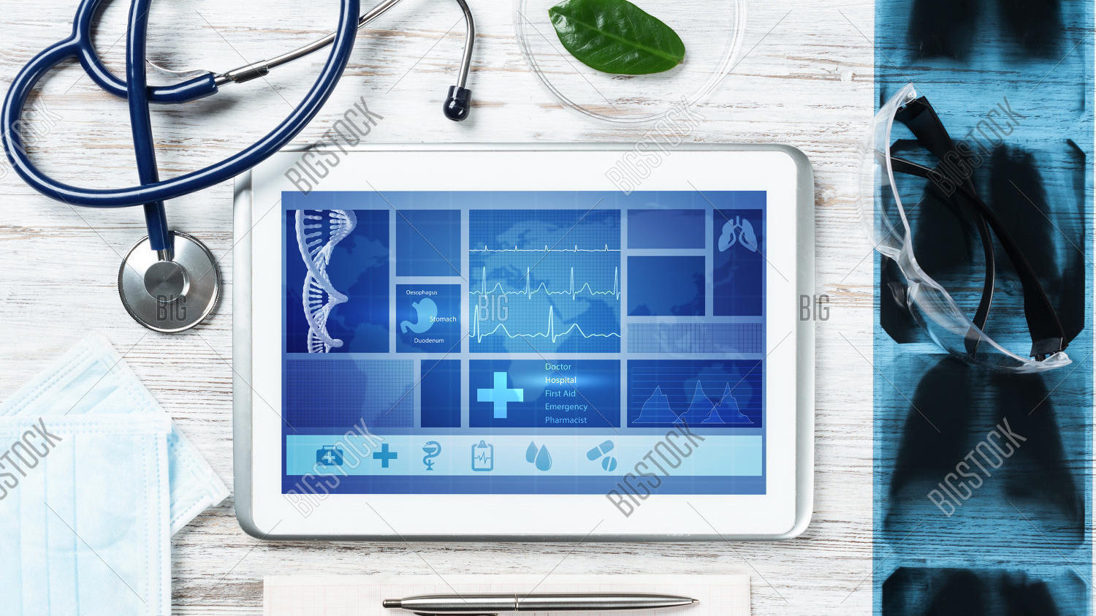

HELP THE PHYSICIAN WITH PATIENT EXAMINATION
With whole record of the patient’s old and current diseases, it can be easy for the physician to identify pattern of diseases, if any. Otherwise, physician may know about diseases which are more common to the patient.
Physician can know the results of test or scans which the patient was supposed to have done with greater in-sights and faster than the traditional system.

Slide 9
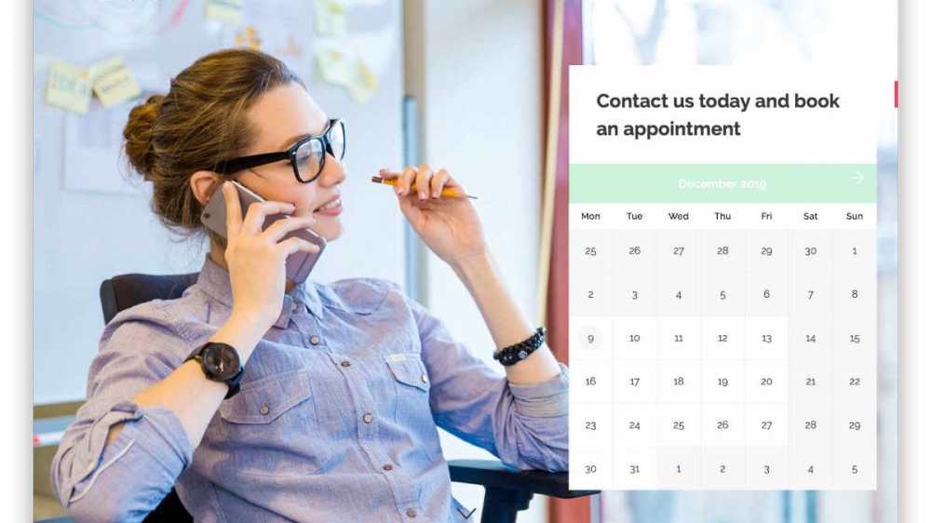
Schedule patient appointments and notify the patients about their appointments
Searching
This feature lets the patients search for the kind of expert consultation they want such as medical consultation or pediatric consultation or for a suitable doctor as per their needs as a part of their complete consultation management. The patients can search doctors using various filters like doctor’s specialty, area, type of care, price, range, preferable time, available insurance, and more. This search feature with advanced filters can make the process of searching doctors streamlined, quick, accurate, and relevant.
Appointment booking
After selecting a suitable doctor, the patient can send a request for the appointment. A built-in chat is also provided so that the patient can discuss any additional issues or queries. Once the doctor and the patient are on the same page by discussing everything out, the doctor can confirm the appointment request.
SOS/Emergency
No one can predict when a medical emergency might occur. That’s why it’s important that in online appointment booking app we provide a feature to manage all the SOS and emergency cases. This feature would allow the user to call for an ambulance directly using their smartphone.
Push notifications
With this feature, the users can get push notifications on their mobile phones even when they are not using it. In addition, the admin can also send reminders about appointments, medicines, and many more.

Slide 10



Reminders For Patients to Taking Medicines
The app will contain a feature which will help the patients to take note of all the medicines and injections prescribed by the doctor along with the timings and method for them to be administered.
This feature will notify the patients at to take the medicines and injections whenever its time, so that patients will never forget to take any of the doses, which’ll help in their efficient recovery.
The medications can be easily updated whenever the doctor advises to change them.

